Slide 1
Chapter 23 Algorithm Efficiency

Slide 2
Objectives
To estimate algorithm efficiency using the Big O notation
To understand growth rates and why constants and smaller terms can be ignored in the estimation
To know the examples of algorithms with constant time, logarithmic time, linear time, log-linear time, quadratic time, and exponential time.
To analyze linear search, binary search, selection sort, and insertion sort

Slide 3
Execution Time
Suppose two algorithms perform the same task such as search (linear search vs. binary search) and sorting (selection sort vs. insertion sort). Which one is better?
Possible solution : implement these algorithms in C++ and run the programs to get execution time.
Problems
Many tasks may be running concurrently on a computer. The execution time of a particular program may be dependent on the system load.
Execution time may be dependent on specific input.
Have to fully implement algorithm

Slide 4
Growth Rate
Difficult to compare algorithms by measuring their execution time.
Solution :
Theoretical approach developed to analyze algorithms independent of computers and specific input.
Approximates the effect of a change on the size of the input.
Can see how fast an algorithm’s execution time increases as the input size increases, so you can compare two algorithms by examining their growth rates.

Slide 5
Big O Notation
Example : Linear Search.
Algorithm compares the key with the elements in the array of size n sequentially until the key is found or the array is exhausted.
Key not in array : Requires n comparisons
Key in array : Requires n/2 comparisons on average.
Algorithm’s execution time is proportional to the size of the array. If you double the size of the array, you will expect the number of comparisons to double Algorithm grows at a linear rate.
Growth rate has an order of magnitude of n.
Computer scientists use the Big O notation to abbreviate for “order of magnitude.”
Using this notation, the complexity of the linear search algorithm is O(n), pronounced as “order of n.”

Slide 6

Big “O” Notation
Let f(n) and g(n) be functions mapping nonnegative integers to reals. Then
f(n) is O(g(n)) if there is a constant c > 0 and an integer n₀ ≥ 0 such that
f(n) ≤ c g(n) for n ≥ n₀
c g(n)
f(n)
n₀
g(n) is upper bound for f(n)

Slide 7
Big “Omega” Notation
Let f(n) and g(n) be functions mapping nonnegative integers to reals. Then
f(n) is Ω(g(n)) if there is a constant c > 0 and an integer n₀ ≥ 0 such that
f(n) ≥ c g(n) for n ≥ n₀
f(n)
c g(n)
n₀
g(n) is lower bound for f(n)

Slide 8
Big “Theta” Notation
Let f(n) and g(n) be functions mapping nonnegative integers to reals. Then
f(n) is Θ(g(n)) if there are constants c₁ > 0 and c₂ > 0 and an integer n₀ ≥ 0 such that
c₁g(n) ≤ f(n) ≤ c₂g(n) for n ≥ n₀
c₂ g(n)
f(n)
c₁ g(n)
n₀
f(n) has same rate of growth as g(n)

Slide 9
Best, Worst, and Average Cases
For the same input size, an algorithm’s execution time may vary, depending on the input.
Best case : fastest execution time
Worst case : slowest execution time
Average case : average execution time over all input cases
Average case most representative, but often difficult to obtain.
Worst case usually easier to obtain.
Useful since actual execution time faster than this.

Slide 10
Ignoring Multiplicative Constants
Linear search algorithm requires n comparisons in the worst-case and n/2 comparisons in the average-case.
Using the Big O notation, both cases require O(n) time.
The multiplicative constant (1/2) can be omitted. Algorithm analysis is focused on growth rate. The multiplicative constants have no impact on growth rates.
Growth rate for n/2 or 100n is the same as n, i.e., O(n) = O(n/2) = O(100n).

Slide 11
Ignoring Non-Dominating Terms
Algorithm for finding maximum in array of size n.
Takes n-1 comparisons to find maximum. efficiency.
As n grows larger, the n part in the expression n-1 dominates the complexity.
Big O notation allows you to ignore the non-dominating part (e.g., -1 in the expression n-1) and highlight the important part (e.g., n in the expression n-1).
So, the complexity of this algorithm is O(n).

Slide 12
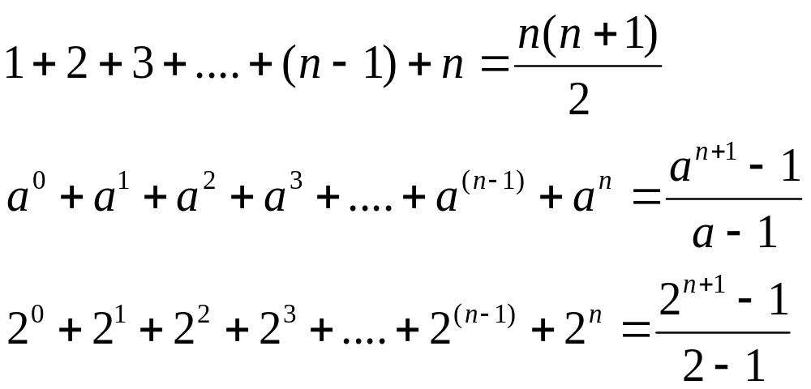
Useful Mathematic Summations

Slide 13
Constant Time
If the time is not related to the input size, the algorithm is said to take constant time with the notation O(1).
For example, a method that retrieves an element at a given index in an array takes constant time, because it does not grow as the size of the array increases.

Slide 14
Examples: Determining Big-O
Repetition
Sequence
Selection
Logarithm

Slide 15
Repetition: Simple Loops
for (i = 1; i <= n; i++) {
k = k + 5;
}
executed
n times
constant time
Time Complexity
T(n) = (a constant c) * n = cn = O(n)
Ignore multiplicative constants (e.g., “c”).

Slide 16
Repetition: Nested Loops
for (i = 1; i <= n; i++) {
for (j = 1; j <= n; j++) {
k = k + i + j;
}
}
executed
n times
inner loop
executed
n times
constant time
Time Complexity
T(n) = (a constant c) * n * n = cn² = O(n²)
Ignore multiplicative constants (e.g., “c”).

Slide 17
Repetition: Nested Loops
for (i = 1; i <= n; i++) {
for (j = 1; j <= i; j++) {
k = k + i + j;
}
}
executed
n times
inner loop
executed
i times
constant time
Time Complexity
T(n) = c + 2c + 3c + 4c + … + nc = cn(n+1)/2 = (c/2)n² + (c/2)n = O(n²)
Ignore non-dominating terms
Ignore multiplicative constants

Slide 18
Repetition: Nested Loops
for (i = 1; i <= n; i++) {
for (j = 1; j <= 20; j++) {
k = k + i + j;
}
}
executed
n times
inner loop
executed
20 times
constant time
Time Complexity
T(n) = 20 * c * n = O(n)
Ignore multiplicative constants (e.g., 20*c)

Slide 19
Sequence
for (j = 1; j <= 10; j++) {
k = k + 4;
}
executed
10 times
for (i = 1; i <= n; i++) {
for (j = 1; j <= 20; j++) {
k = k + i + j;
}
}
executed
n times
inner loop
executed
20 times
Time Complexity
T(n) = c *10 + 20 * c * n = O(n)

Slide 20

Selection
O(n)
if (list.contains(e)) {
System.out.println(e);
}
else
for (Object t: list) {
System.out.println(t);
}
Let n be
list.size().
Executed
n times.
Time Complexity
T(n) = test time + worst-case (if, else)
= O(n) + O(n)
= O(n)

Slide 21

Logarithm: Analyzing Binary Search
Binary search searches a key in a sorted array.
Each iteration in the algorithm contains a fixed number of operations, denoted by c. Let T(n) denote the time complexity for a binary search on a list of n elements.
Without loss of generality, assume n is a power of 2 and k=logn.
Since binary search eliminates half of the input after two comparisons,

Slide 22
Logarithmic Time
Algorithm with the O(logn) time complexity is called a logarithmic algorithm.
Base of the log is 2, but the base does not affect a logarithmic growth rate, so it can be omitted.
The logarithmic algorithm grows slowly as the problem size increases.
If you square the input size, you only double the time for the algorithm.

Slide 23
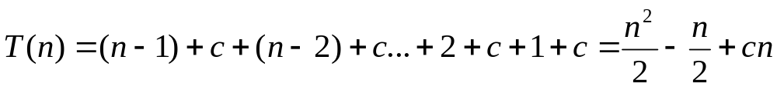
Analyzing Selection Sort
Selection sort algorithm sorts array of size n by
Finding largest number in array and placing it last position.
Finding largest number remaining and placing it next to last, and so on until there only a single number remaining.
The number of comparisons is n-1 for the first iteration, n-2 for the second iteration, and so on.
Let T(n) denote the complexity for selection sort and c denote the total number of other operations such as assignments and additional comparisons in each iteration. So,
The complexity of the selection sort algorithm is O(n²).

Slide 24
Quadratic Time
An algorithm with the O(n²) time complexity is called a quadratic algorithm.
The quadratic algorithm grows quickly as the problem size increases.
If you double the input size, the time for the algorithm is quadrupled.
Algorithms with a nested loop are often quadratic.

Slide 25
Analyzing Insertion Sort
Insertion sort algorithm and array of size n by
Repeatedly inserting a new element into a sorted partial array until the whole array is sorted.
At the kth iteration, to insert an element to a array of size k, it may take k comparisons to find the insertion position, and k moves to insert the element.
Let T(n) denote the complexity for insertion sort and c denote the total number of other operations such as assignments and additional comparisons in each iteration. So,
Ignoring constants and smaller terms, the complexity of the insertion sort algorithm is O(n²).

Slide 26






Comparing Common Growth Functions
Constant time
Logarithmic time
Linear time
Log-linear time
Quadratic time
Cubic time
Exponential time

Slide 27
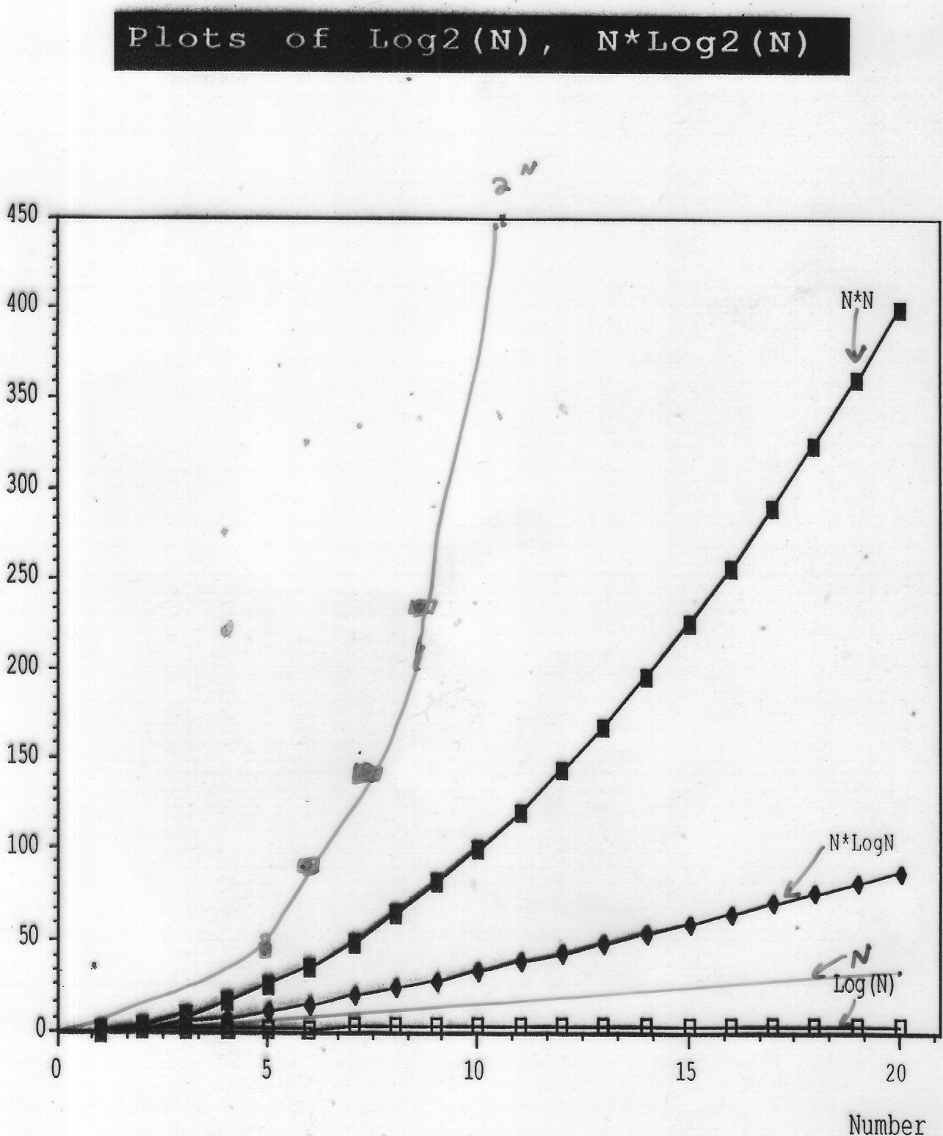

Slide 28
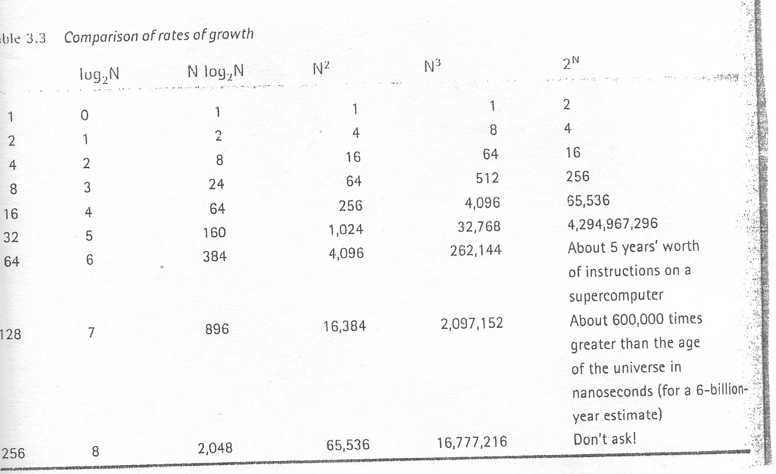

Slide 29
Case Study: Fibonacci Numbers
/** The method for finding the Fibonacci number */
public static long fib(long index) {
if (index == 0) // Base case
return 0;
else if (index == 1) // Base case
return 1;
else // Reduction and recursive calls
return fib(index - 1) + fib(index - 2);
}

Slide 30
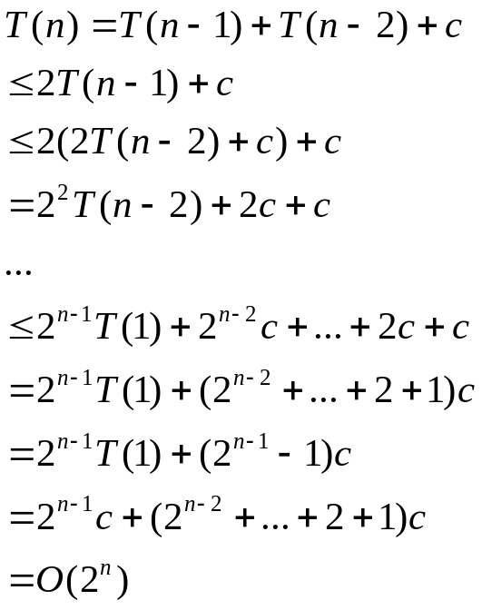
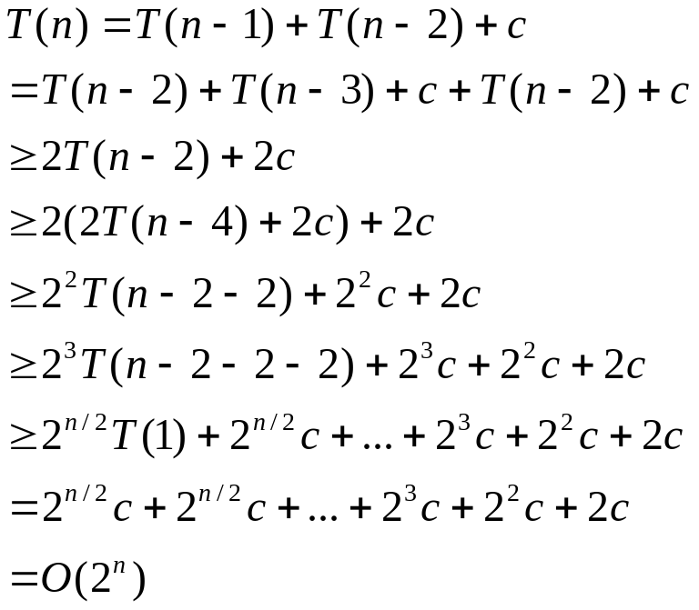
Complexity for Recursive Fibonacci Numbers
Since
and
Therefore, the recursive Fibonacci method takes
.

Slide 31

Case Study: Non-recursive version of Fibonacci Numbers
/** The method for finding the Fibonacci number */
public static long fib(long n) {
if (n == 0 || n == 1)
return n;
long f0 = 0; // For fib(0)
long f1 = 1; // For fib(1)
long currentFib = 1; // For fib(2)
for (int i = 2; i <= n; i++) {
currentFib = f0 + f1;
f0 = f1;
f1 = currentFib;
}
return currentFib;
}
Obviously, the complexity of this new algorithm is . This is a tremendous improvement over the recursive algorithm.

Slide 32
Case Study: GCD Algorithms Version 1
public static int gcd(int m, int n) {
int gcd = 1;
for (int k = 2; k <= m && k <= n; k++) {
if (m % k == 0 && n % k == 0)
gcd = k;
}
return gcd;
}
Obviously, the complexity of this algorithm is .

Slide 33
Case Study: GCD Algorithms Version 2
for (int k = n; k >= 1; k--) {
if (m % k == 0 && n % k == 0) {
gcd = k;
break;
}
}
The worst-case time complexity of this algorithm is still .

Slide 34
Case Study: GCD Algorithms Version 3
public static int gcd(int m, int n) {
int gcd = 1;
if (m == n) return m;
for (int k = n / 2; k >= 1; k--) {
if (m % k == 0 && n % k == 0) {
gcd = k;
break;
}
}
return gcd;
}
The worst-case time complexity of this algorithm is still .

Slide 35
Euclid’s algorithm
Let gcd(m, n) denote the gcd for integers m and n:
If m % n is 0, gcd (m, n) is n.
Otherwise, gcd(m, n) is gcd(n, m % n).
m = n*k + r
if p is divisible by both m and n
m / p = n*k/p + r/p

Slide 36
Euclid’s Algorithm Implementation
public static int gcd(int m, int n) {
if (m % n == 0)
return n;
else
return gcd(n, m % n);
}
The time complexity of this algorithm is O(logn).

Slide 37
Finding Prime Numbers
Compare three versions:
Brute-force
Check possible divisors up to Math.sqrt(n)
Check possible prime divisors up to Math.sqrt(n)

Slide 38
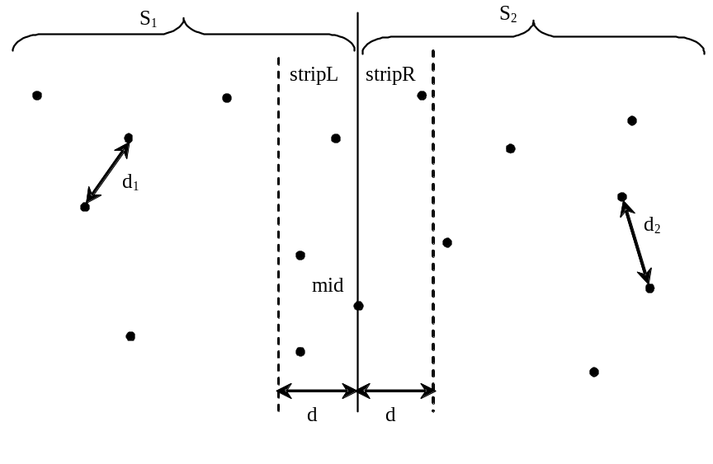
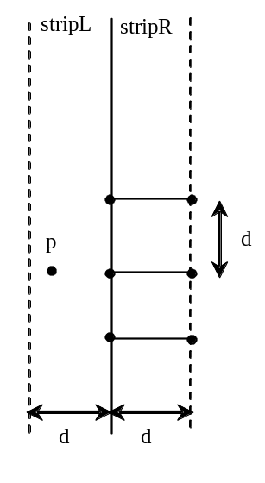
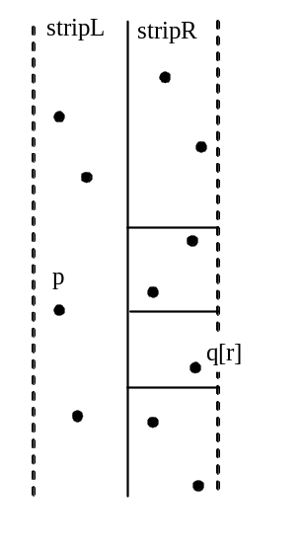
Case Study: Closest Pair of Points

Slide 39
Practical Considerations
The big O notation provides a good theoretical estimate of algorithm efficiency.
However, two algorithms of the same time complexity are not necessarily equally efficient.
Notation only measures rate of growth and ignores constant and multiplicative terms.

Slide 40
Caveats
We must be careful in using this form of analysis in case the constant factors are large.
Two algorithms of the same order e.g. O(n), may have very different running times depending on their (hidden) constants.
Generally an algorithm of a lower order,eg O(n), will be better than a higher order one, e.g O(n²), but this is not always the case for smaller n, when the higher order algorithm may have a much lower overhead.

Slide 41
n 20 50 100 1000
f(n) = 100n 2000 5000 10000 100000
f(n) = 0,5n² 200 1250 5000 500000
f(n) = 10¹⁰⁰n ?? ?? ?? ??

